Slide 1
The “F” In FOSS
Affording Open Source In Developing Countries

Slide 2



whoami
Ahmed Sobeh
Engineering Manager @ Aiven
Worked with and led diverse teams
Born and raised in a country that tries to be developing
github.com/ahmedsobeh
linkedin.com/ahmedsobeh
twitter.com/ahmedszakaria

Slide 3
Background

Slide 4
What is a developing Country?
Notes:
The term was coined in 1960 by Walt Whitman Rostow, in his classical piece, The Stages of Economic Growth: A Non-Communist Manifesto (1960)

Slide 5
What is a developing Country?
And does it mean now what it meant before?
Notes:
The term was coined in 1960 by Walt Whitman Rostow, in his classical piece, The Stages of Economic Growth: A Non-Communist Manifesto (1960)

Slide 6
What is a developing country?
Actually developing
And does it mean now what it meant before?

Slide 7
What is a developing country?
Actually developing
Trying to develop
And does it mean now what it meant before?

Slide 8
What is a developing country?
Actually developing
Trying to develop
Stagnant - “Left behind”
And does it mean now what it meant before?

Slide 9
The Current State
Notes:
The term was coined in 1960 by Walt Whitman Rostow, in his classical piece, The Stages of Economic Growth: A Non-Communist Manifesto (1960)

Slide 10
Actual conversation from twitter
Angry Person: They STOLE our work and they’re building new stuff with it!!!

Slide 11
Actual conversation from twitter
Angry Person: They STOLE our work and they’re building new stuff with it!!!
Random Person: Isn’t that the whole point of open-source?

Slide 12
Actual conversation from twitter
Angry Person: They STOLE our work and they’re building new stuff with it!!!
Random Person: Isn’t that the whole point of open-source?
Angry Person: Maybe it is but it’s still stealing in my view

Slide 13
A Question asked at a team meeting
What does Open Source mean to you?

Slide 14
A Question asked at a team meeting
What does Open Source mean to you?
Answer A: Free Software that I can use without paying

Slide 15
A Question asked at a team meeting
What does Open Source mean to you?
Answer A: Free Software that I can use without paying
Answer B: I gotta check with IT before I install any of those

Slide 16
A Question asked at a team meeting
What does Open Source mean to you?
Answer A: Free Software that I can use without paying
Answer B: I gotta check with IT before I install any of those
Answer C: I gotta check with the security team before I use any of those?

Slide 17
A Question asked at a team meeting
What does Open Source mean to you?
Answer A: Free Software that I can use without paying
Answer B: I gotta check with IT before I install any of those
Answer C: I gotta check with the security team before I use any of those?
My Answer: I don’t have to wait for the next release, I can fix the bug myself locally
Notes:
None of these answers touch the main essence of open source, sustainability, community collaboration, decentralization or transparency

Slide 18
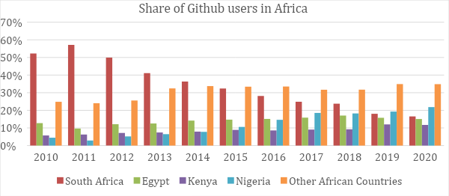
How Is It Right Now?
Africa
Notes:
https://www.ictworks.org/africans-contribute-open-source-software/#.Y_E5kXaZPao The share of Github users that contribute to open source was dominated by South Africa a decade ago, reaching over 50% in 2011, but this dominance has been challenged by a rapid growth in open source contributions from Kenya and Nigeria. Nigeria became the country with the largest number of contributing Github users in 2019, and held that position in 2020, with South Africa in second place, Egypt in third place, and Kenya in the fourth place.

Slide 19
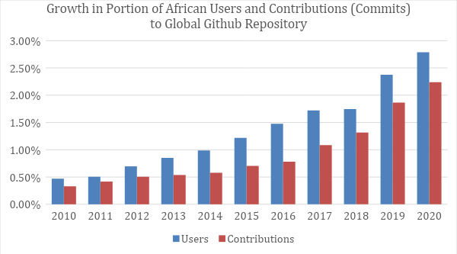
How Is It Right Now?
Africa
Notes:
https://www.ictworks.org/africans-contribute-open-source-software/#.Y_E5kXaZPao We analysed general trends of open source contributions from African users between 2010 and 2020 and discovered that there has been a general increase in the share of contributing Github authors in Africa, from just under 0.5% in 2010 to approximately 2.7% in 2020. The share of actual total contributions from African authors similarly grew from 0.3% in 2010 to approximately 2.3% in 2020.

Slide 20
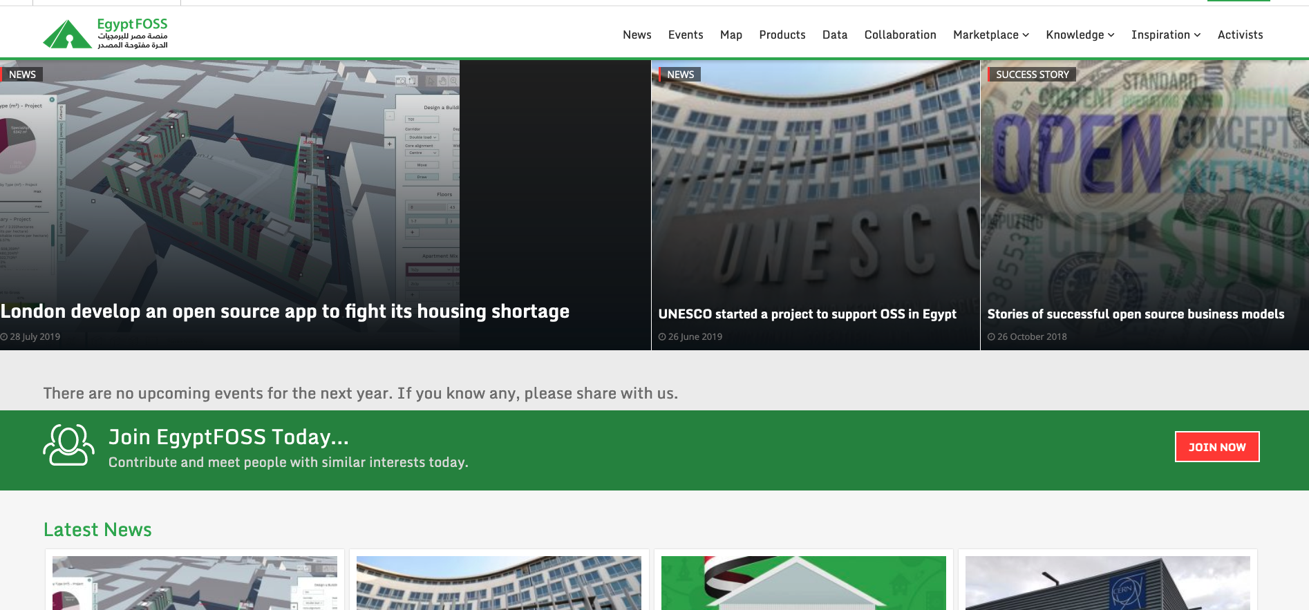
How Is It Right Now?
Notes:
https://izbicki.me/blog/teaching-open-source-in-north-korea.html

Slide 21
Why should we care?
Notes:
Open source software can provide a low-cost alternative to proprietary software, enabling more people to participate in the digital economy. This, in turn, can help to close the digital divide and promote economic development. Also promotes digital literacy, skills development. Transparency would also build local trust and innovation. And solve local problems

Slide 22
Why Should We Care?
Top 10 countries to outsource software development
India | Ukraine
China | Poland
The Philippines | Romania
Brazil | Taiwan
Egypt | Canada
Notes:
https://www.codeinwp.com/blog/best-countries-to-outsource-software-development/

Slide 23
Challenges
Notes:
Issues you can’t relate to, struggles you might find trivial and ideas you might think are already everywhere

Slide 24
Challenges deep-dive
Society and Culture

Slide 25
Challenges deep-dive
Resources and Infrastructure
Society and Culture

Slide 26
Challenges deep-dive
Resources and Infrastructure
Governance
Society and Culture

Slide 27
Society and Culture

Slide 28
Open Source Culture
Open and transparent

Slide 29
Open Source Culture
Open and transparent
Information should be as freely and publicly accessible as possible

Slide 30
Open Source Culture
Open and transparent
Free
Information should be as freely and publicly accessible as possible

Slide 31
Open Source Culture
Open and transparent
Free
Information should be as freely and publicly accessible as possible
Distributed modes of collaboration, in which large groups of people work together without a strongly centralized authority directing them, are highly effective

Slide 32
Open Source Culture
Open and transparent
Free
Dynamic
Information should be as freely and publicly accessible as possible
Distributed modes of collaboration, in which large groups of people work together without a strongly centralized authority directing them, are highly effective

Slide 33
Open Source Culture
Open and transparent
Free
Dynamic
Information should be as freely and publicly accessible as possible
Distributed modes of collaboration, in which large groups of people work together without a strongly centralized authority directing them, are highly effective
Being resistant to change and preferring to stick with traditional approaches can limit society’s willingness to adopt new technologies and solutions.

Slide 34
Open Source Culture
Open and transparent
Free
Dynamic
Information should be as freely and publicly accessible as possible
Distributed modes of collaboration, in which large groups of people work together without a strongly centralized authority directing them, are highly effective
Being resistant to change and preferring to stick with traditional approaches can limit society’s willingness to adopt new technologies and solutions. Why?

Slide 35
Open Source Culture
Open and transparent
Free
Dynamic
Information should be as freely and publicly accessible as possible
Distributed modes of collaboration, in which large groups of people work together without a strongly centralized authority directing them, are highly effective
Being resistant to change and preferring to stick with traditional approaches can limit society’s willingness to adopt new technologies and solutions. Why?
Fear of the unknown

Slide 36
Open Source Culture
Open and transparent
Free
Dynamic
Information should be as freely and publicly accessible as possible
Distributed modes of collaboration, in which large groups of people work together without a strongly centralized authority directing them, are highly effective
Being resistant to change and preferring to stick with traditional approaches can limit society’s willingness to adopt new technologies and solutions. Why?
Fear of the unknown
Competence
Accountability

Slide 37
Economy and Infrastructure

Slide 38
Economical Challenges
Access
Equipment and internet

Slide 39
Economical Challenges
Access
Equipment and internet
Education and self learning

Slide 40
Economical Challenges
Access
Equipment and internet
Education and self learning
How do you create a community?

Slide 41
Economical Challenges
Access
Funding
Equipment and internet
Education and self learning
How do you create a community?
Projects would depend on individuals

Slide 42
Economical Challenges
Access
Funding
Equipment and internet
Education and self learning
How do you create a community?
Projects would depend on individuals
Individuals would prioritize paid work

Slide 43
Economical Challenges
Access
Funding
Equipment and internet
Education and self learning
How do you create a community?
Projects would depend on individuals
Individuals would prioritize paid work
Documentation, marketing and community building

Slide 44
Economical Challenges
Access
Funding
Equipment and internet
Education and self learning
How do you create a community?
Projects would depend on individuals
Individuals would prioritize paid work
Documentation, marketing and community building
Can’t attract or maintain volunteers

Slide 45
Economical Challenges
Access
Funding
Localization
Equipment and internet
Education and self learning
How do you create a community?
Projects would depend on individuals
Individuals would prioritize paid work
Documentation, marketing and community building
Can’t attract or maintain volunteers
No entry point

Slide 46
Economical Challenges
Access
Funding
Localization
Equipment and internet
Education and self learning
How do you create a community?
Projects would depend on individuals
Individuals would prioritize paid work
Documentation, marketing and community building
Can’t attract or maintain volunteers
No entry point
Very difficult to get started

Slide 47
Economical Challenges
Access
Funding
Localization
Equipment and internet
Education and self learning
How do you create a community?
Projects would depend on individuals
Individuals would prioritize paid work
Documentation, marketing and community building
Can’t attract or maintain volunteers
No entry point
Very difficult to get started
Time and resources needed would discourage potential contributors

Slide 48
Governance

Slide 49
Governance
Employee contracts

Slide 50
Governance
Employee contracts
Intellectual property laws

Slide 51
Governance
Employee contracts
Intellectual property laws
Proprietary software deals

Slide 52
What Can We Do?

Slide 53
InnerSource

Slide 54
InnerSource
Organizations can begin to develop a culture of open collaboration and transparency

Slide 55
InnerSource
Organizations can begin to develop a culture of open collaboration and transparency
Innersource can help to promote the development of internal expertise in OSS development

Slide 56
InnerSource
Organizations can begin to develop a culture of open collaboration and transparency
Innersource can help to promote the development of internal expertise in OSS development
Innersource can help to reduce costs associated with proprietary software

Slide 57
InnerSource
Organizations can begin to develop a culture of open collaboration and transparency
Innersource can help to promote the development of internal expertise in OSS development
Innersource can help to reduce costs associated with proprietary software
Government agencies can begin to build relationships with open source communities and vendors, which can help to facilitate future open source adoption

Slide 58
Education

Slide 59
Education
Provide free technical education

Slide 60
Education
Provide free technical education
Localization education

Slide 61
Education
Provide free technical education
Localization education
Business awareness

Slide 62
Education
Provide free technical education
Localization education
Business awareness
Community education

Slide 63
Localization

Slide 64
Localization
Invest in localization

Slide 65
Localization
Invest in localization
Provide training and support

Slide 66
Localization
Invest in localization
Provide training and support
Foster partnerships

Slide 67
Localization
Invest in localization
Provide training and support
Foster partnerships
Overcoming language barriers

Slide 68
Localization
Invest in localization
Provide training and support
Foster partnerships
Overcoming language barriers
Encouraging local participation
Enhancing usability

Slide 69
Governance

Slide 70
Governance
Create favorable intellectual property laws
Notes:
Governments can create favorable intellectual property laws that incentivize the development of OSS and protect the rights of developers. This can include stronger protections for open source licenses and patents, and support for community-driven licensing models.

Slide 71
Governance
Create favorable intellectual property laws
Create partnerships with Open Source organizations
Notes:
Governments can create favorable intellectual property laws that incentivize the development of OSS and protect the rights of developers. This can include stronger protections for open source licenses and patents, and support for community-driven licensing models.

Slide 72
Governance
Create favorable intellectual property laws
Create partnerships with Open Source organizations
Support community driven initiatives
Notes:
Governments can create favorable intellectual property laws that incentivize the development of OSS and protect the rights of developers. This can include stronger protections for open source licenses and patents, and support for community-driven licensing models.

Slide 73
Let them in!

Slide 74
Let them in!
Cultural acceptance
Notes:
Governments can create favorable intellectual property laws that incentivize the development of OSS and protect the rights of developers. This can include stronger protections for open source licenses and patents, and support for community-driven licensing models.

Slide 75
Let them in!
Cultural acceptance - “Cultural Relativism” Talk
Notes:
Governments can create favorable intellectual property laws that incentivize the development of OSS and protect the rights of developers. This can include stronger protections for open source licenses and patents, and support for community-driven licensing models.

Slide 76
Let them in!
Cultural acceptance - “Cultural Relativism” Talk
Mentorship
Notes:
Governments can create favorable intellectual property laws that incentivize the development of OSS and protect the rights of developers. This can include stronger protections for open source licenses and patents, and support for community-driven licensing models.

Slide 77
Let them in!
Cultural acceptance - “Cultural Relativism” Talk
Mentorship
Use your languages!
Notes:
Governments can create favorable intellectual property laws that incentivize the development of OSS and protect the rights of developers. This can include stronger protections for open source licenses and patents, and support for community-driven licensing models.

Slide 78
Thank You!

